Slide 1


Modelisation of laser pulse heating of TiN/GST/Si layers
Simon Schmit, July 2025

Slide 2
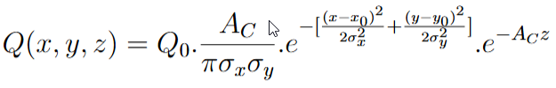
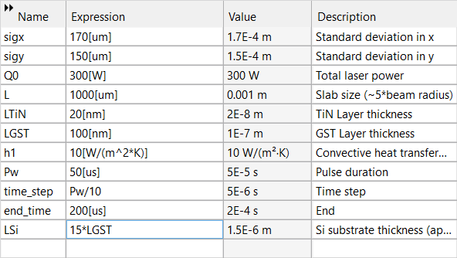
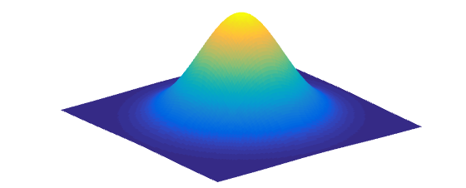
Heat input profile (beam modelling) and parameters
Updated 2D Gaussian heat input :
Parameters :

Slide 3
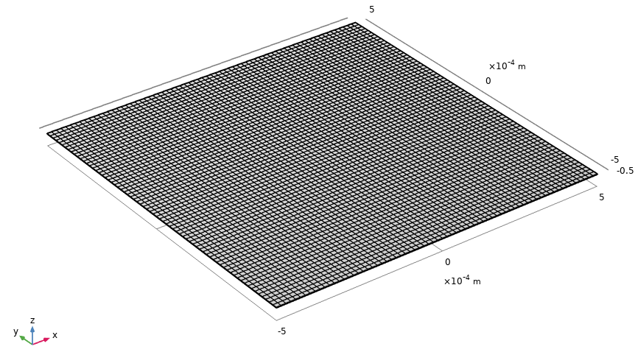
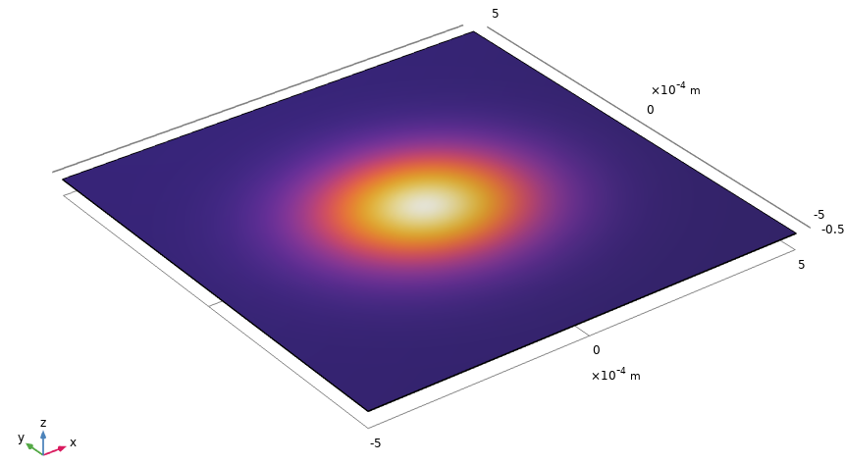

Geometry and mesh of the layers
TiN
GST225
Si

Slide 4
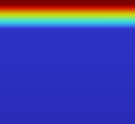
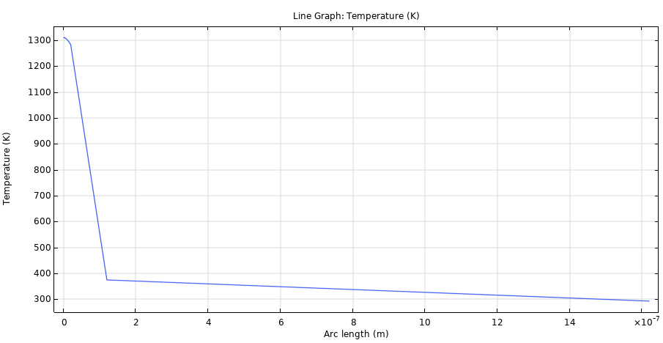
Temperature gradient at the end of the pulse
20 nm
TiN
100 nm
Ge2Sb2Te5
Substrate (1500nm)
Si

Slide 5
Temperature gradient at the end of the pulse
20 nm
100 nm
Substrate (1500nm)

Slide 6
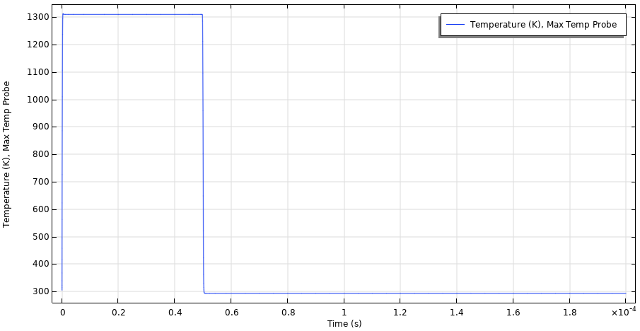
Temperature vs time at the middle of the laser beam on TiN layer surface (x=0, y=0)

Slide 7
Maximum temperature depending on the laser power
Power (W) | Temperature max (K)
200 | 971.35
300 | 1310.4
350 | 1480
400 | 1649.5
500 | 1988.6
750 | 2836.4
1200 | 4362.3

